Slide 1
KERALA CONSULTANCY COUNCIL
WOMEN´S INDIAN CHAMBER OF COMMERCE AND INDUSTRY
www.wicci.in

Slide 2
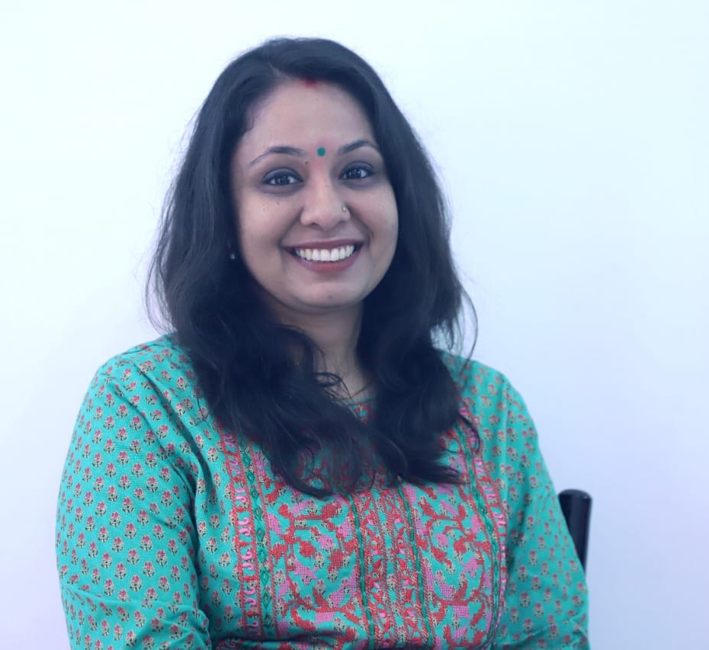
Devaki R Menon, President
KERALA CONSULTANCY COUNCIL WICCI
BIO :
Management Consulting Practitioner
Founder and CEO of Kacchapi, The Business Clinic, Registered at Mizone Kannur
Clientele – MSME Enterprises
Focus on Change Management, Organization Development, Entrepreneur Coaching, Employment Training, Business Research and Implementation of strategies and technology for future proofing.

Slide 3
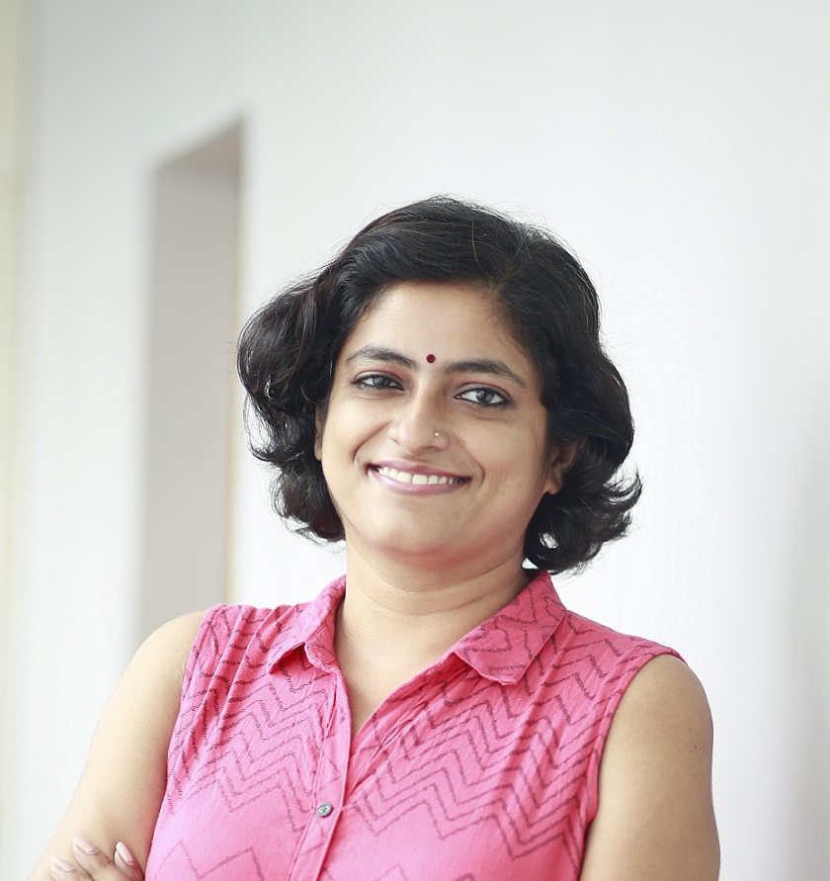
Bhavya Nandakumar, Digital Strategist
COUNCIL MEMBER, KERALA CONSULTANCY COUNCIL WICCI
BIO :
Bhavya Nandakumar, the founder of Shepreneur Hub, is an MBA in HR & Marketing; a published author, speaker, and trainer who has a keen interest in empowering women entrepreneurs. She has more than 10 years of digital marketing experience and is passionate about advertising, writing, and humans in general. She has trained over a 1000 students in digital marketing and also has been featured in various magazines for her contributions to the industry

Slide 4
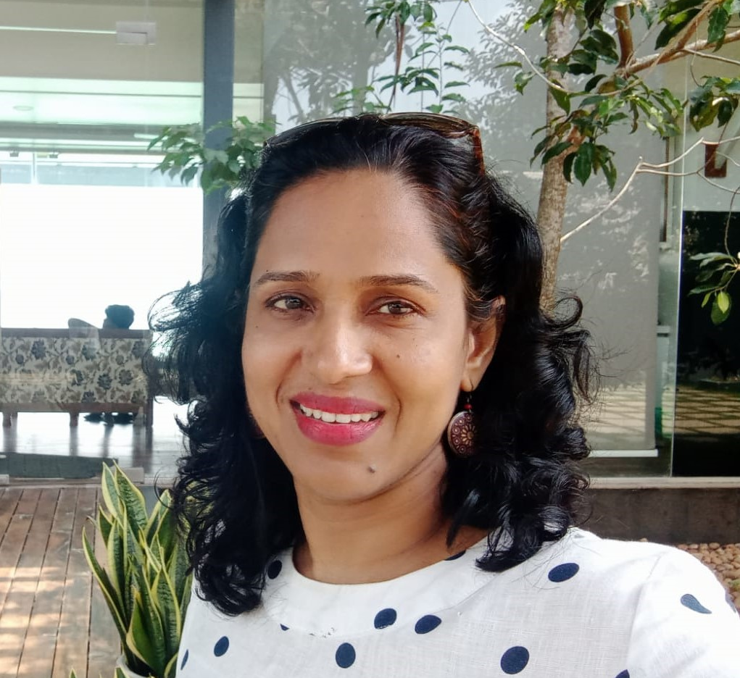
Vincy Seju, Media Consultant
COUNCIL MEMBER, KERALA CONSULTANCY COUNCIL WICCI
BIO :
Journalist by Profession
Has more than 25 years of experience in media, worked in front line print and online news papers
Passionate to be engaged in contributing articles for newspaper and women's magazine
Loves baking and selling of cakesand pasteries (Vincy Patisserie) – a home baker who makes delicious cakes with customized designs as required by her customers

Slide 5
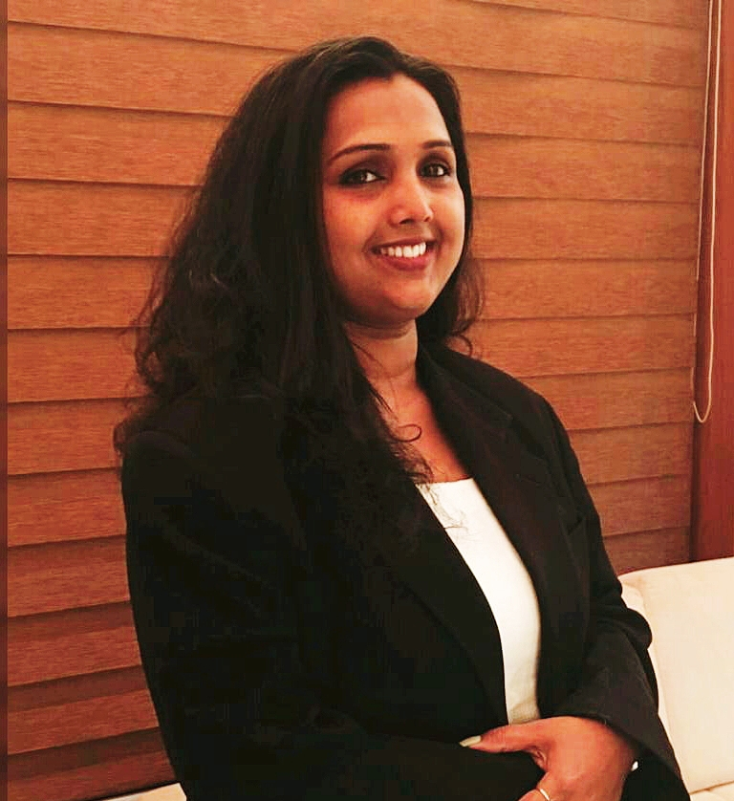
Siji Gijino, Legal Advisor
COUNCIL MEMBER, KERALA CONSULTANCY COUNCIL WICCI
BIO :
Well educated and accomplished lawyer offering a strong attention to detail and accuracy and excellent critical thinking and research skills with 17 years of extensive field experience and determination to achieve great results.
17 years of active practice as an advocate at the following Courts in Kerala, India:- District Court and Additional District Court, Munsiff Courts, Judicial First Class Magistrate Court, Motor Accident Claims Tribunal & Other Quazi Judicial Forum.

Slide 6
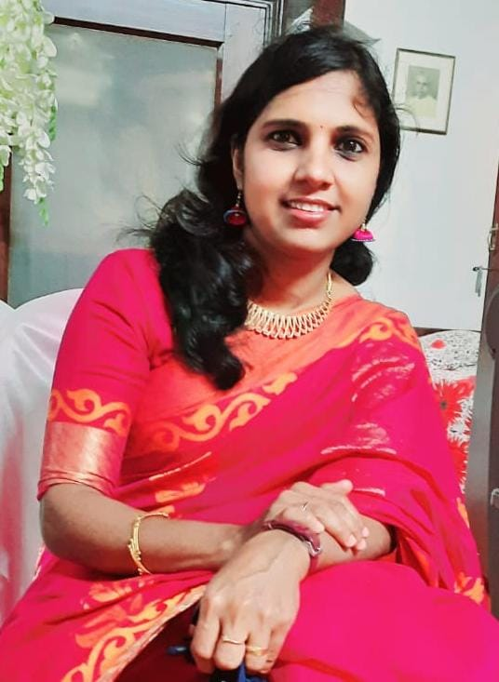
Rajitha P.K
COUNCIL MEMBER, KERALA CONSULTANCY COUNCIL WICCI
BIO :
A woman Entrepreneur who is productively engaged in an online boutique business named
“Tulip The Natural Design”
Had worked as a teacher in Army Public Primary School in Andaman.
Fashion Designer
Passionate writer of Articles in Malayalam.
Very enthusiastic in women empowerment activities

Slide 7
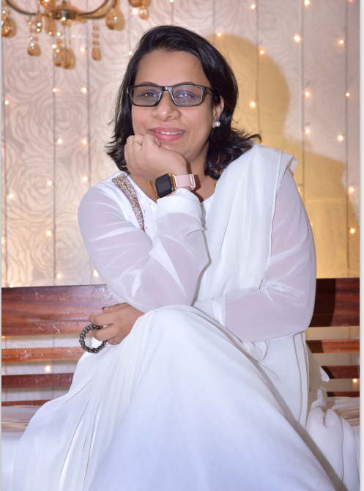
Sherin Hasan
COUNCIL MEMBER, KERALA CONSULTANCY COUNCIL WICCI
BIO :
Passionate woman entrepreneur Sherin Hasan. She is running traditional cook wares store FERRITE CASTIRON in Kochi.
Had worked has a vice president assistant in HKBK ENGINEERING COLLEGE Bangalore.
Events and exhibitions being conducted among women entrepreneurs
Passionate in Digital Marketing

Slide 8
SUPPORTED BY
WICCI is supported by the massive global networks of ALL Ladies League (ALL), Women Economic Forum (WEF), and SHEconomy.
ALL is a movement of ‘Sisters Beyond Borders.’
WEF is a platform for ‘Business Beyond Borders.’ SHEconomy is e-commerce for women worldwide in Goods & Services for ‘Commerce Beyond Borders’

Slide 9
COUNTRIES REPRESENTED
Albania, Angola, Armenia, Argentina, Australia, Azerbaijan, Bangladesh, Brazil, Burundi, Cameroon, Canada, Chad, China, Costa Rica, Croatia, Cyprus, Czech Republic, Colombia, Ecuador, Egypt, Ghana, Germany, Greece, Guatemala, Hong Kong, Hungary, India, Italy, Israel, Ireland, Japan, Kazakhstan, Kenya, Kyrgyzstan, Lesotho, Luxembourg, Malawi, Malaysia, Mexico, Moldova, Monaco, Montenegro, Morocco, Mozambique, Malta, Netherlands, Nigeria, Nepal, New Zealand, North Macedonia, Norway, Paraguay, Portugal, Peru, Puerto Rico, Philippines, Qatar, Romania, Russia, Rwanda, Serbia, Singapore, Slovenia, Spain, South Africa, South Korea, Suriname, Sweden, Switzerland, Syria, Tunisia, Turkey, Uganda, Ukraine, UK, Uruguay, Venezuela, Vietnam, Virgin Islands (US), UAE, USA, Uzbekistan, Zimbabwe.

Slide 10
WOMEN'S INDIAN CHAMBER OF COMMERCE ANDINDUSTRY

